Slide 1


WEB-API MetropolyTAN project - Final presentation
Boluwatife ABIONA
David MONNIER
Julien MOURCELY
Ahmed-Imad HAMAILI
24th June, 2025 - EIPHI Graduate School, Montbeliard

Slide 2
Table of content
1. Project presentation
2. Global architecture
3. Organisation
4. Advancements
5. What’s next ?
6. Conclusion
4. Advancements

Slide 3
Presentation of our project
Service for eastern cities and regions of France
Multi-modal app for authorities of mobility to optimize their offer:
Trains
Bus
Carpooling
Modes:
Complete data visualization
Web API

Slide 4
Presentation of our project (2/2)
Goal : 2025 and beyond is the era of public mobility
Technical part : divides in :
Data aggregation
Data visualization
Data modeling and database
Web API and interface

Slide 5
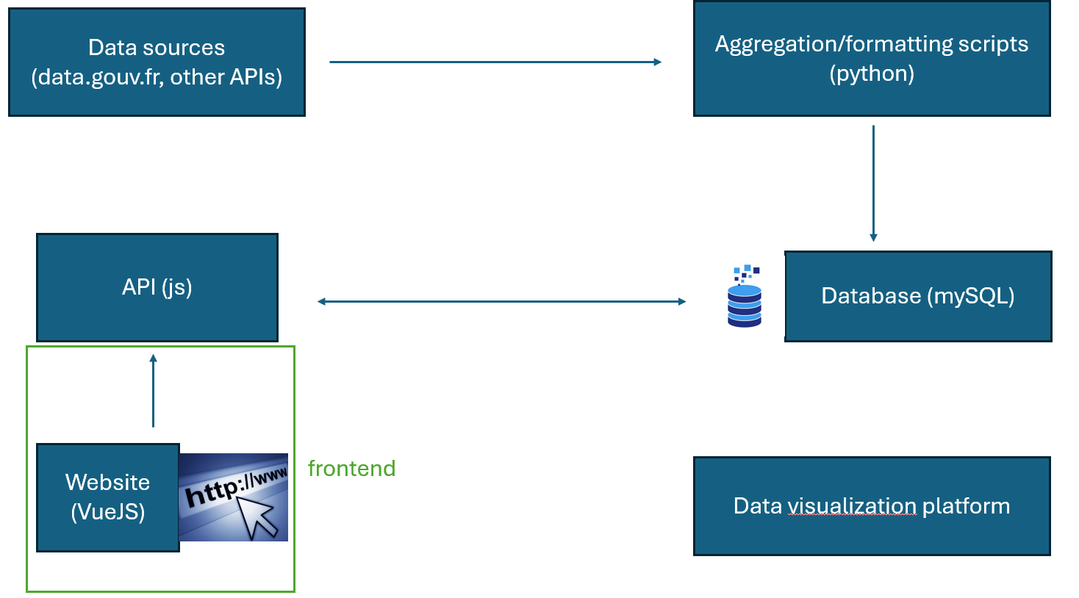
Global architecture

Slide 6
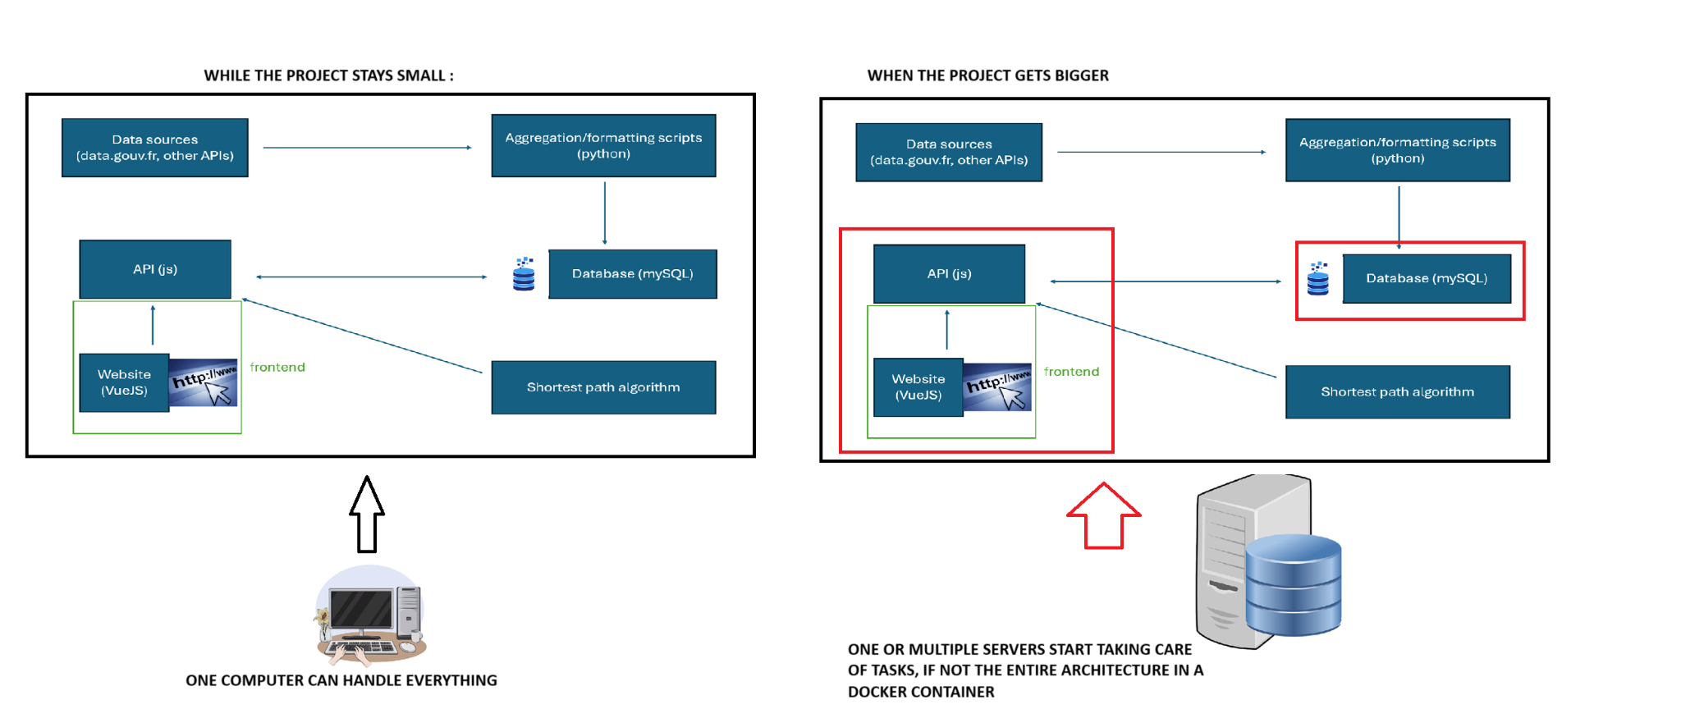
Global architecture

Slide 7
Global architecture
Roles : Data analyst, user support, developers (API and Algorithm) / Site admin - visitor
Hardware and software
Computer (good enough to program)
IDE
Data visualisation libraries
Version control tools (Git)
Management tools (Trello)

Slide 8
Organisation
Worked with SCRUM Agile Method
Appointments every two weeks
Same with sprints
The project was split in half
David and Julien on the API and Web Interface
Abiona and Ahmed-Imad on the data aggregation and visualisation

Slide 9
Advancements back in December
Database : modelled and reviewed/updated it, bulletproof and ready to be used
Data aggregation and visualisation : aggregated Belfort info, visualized Montbeliard & Belfort

Slide 10
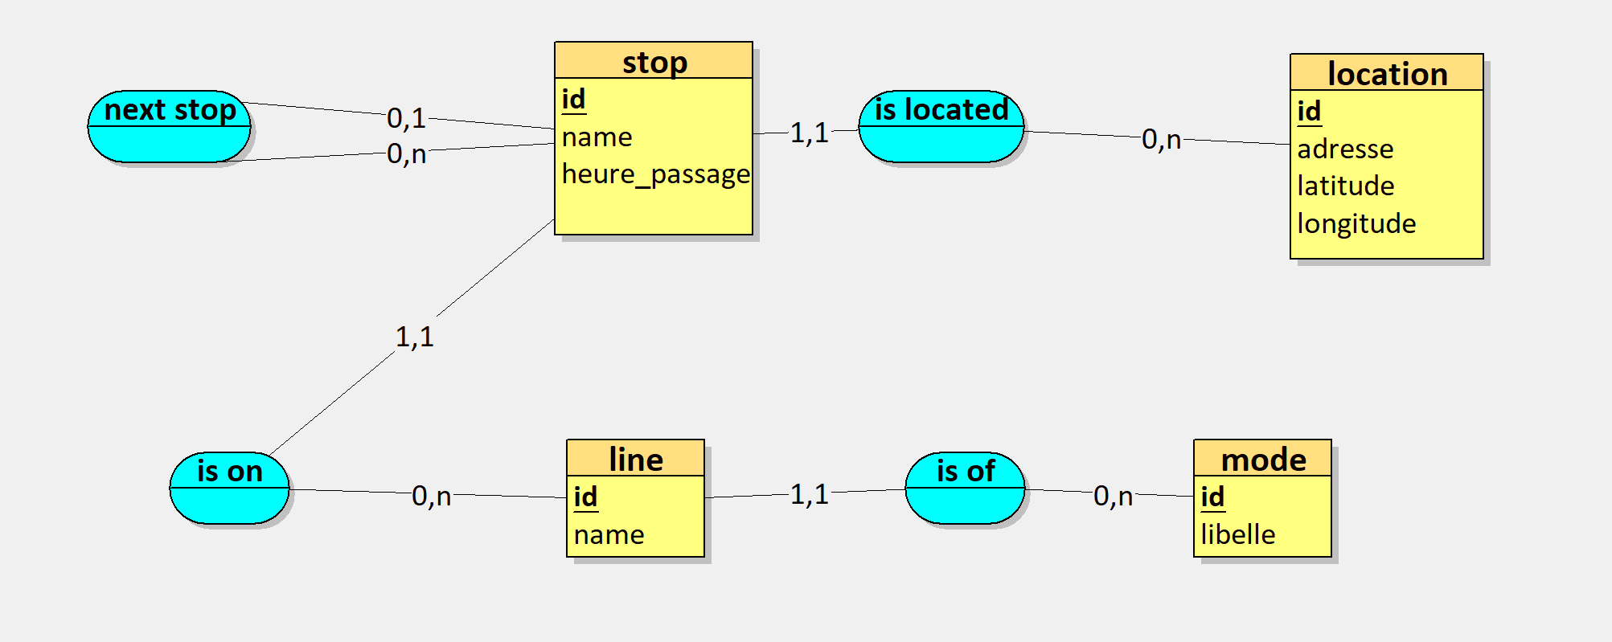
Database structure
We eventually settled for a simple modeling structure
Stop represents a given stop of any kind with a PRECISE time (for example in Sevenans, “Oeufs Frais” - 8h28). Stops are linked between them and obviously linked to a location
Stops are linked to a line (for example “Oeufs Frais” is linked to Line 3)
Lines are linked to a mode (Bus, Train, Carpooling…). For example, Line 3 is a Bus Line (Optymo - Belfort)

Slide 11
Data aggregation
Data that will be fed to the database is aggregated from data.gouv.fr using scrapers
GTFS format is used and converted to CSV-like files that fit our database structure (Python Script part 1)
Those CSV files are then inserted by batch inside the database using a Python script
Unlike the rest of the architecture, those scripts don’t run 24/7. Just when we need them

Slide 12
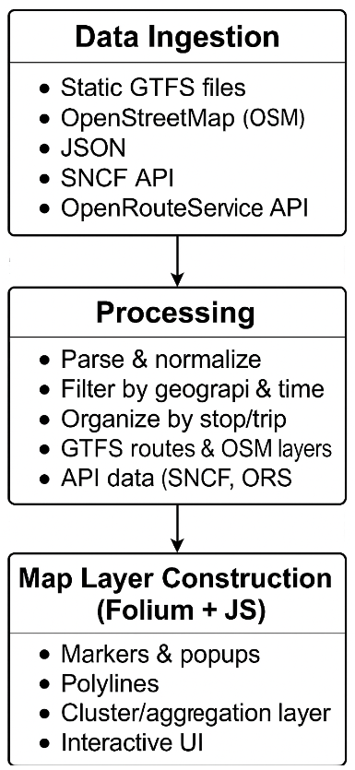
Data Visualization
1. Data Ingestion
We collect data from GTFS files(Montbéliard & belfort & flix & mobigo buses), JSON feeds (bike stations), real-time APIs (SNCF, OpenRouteService), and OpenStreetMap. Python scripts load and standardize all inputs.
2. Processing
Data is parsed and filtered by time and region. Stops, trips, and schedules are linked. Missing GTFS shapes are computed via OpenRouteService and cached in JSON files. OSM is used to extract vehicle and bicycle routes and parking for map layers.
3. Map Layer Construction
All transport types (bus, train, bike, parking) are displayed on an interactive OpenStreetMap-based map using Folium. Real-time popups, filtering, clustering, and route highlights are supported via JavaScript.

Slide 13
Class Diagram
https://postimg.cc/SntDj64W

Slide 14
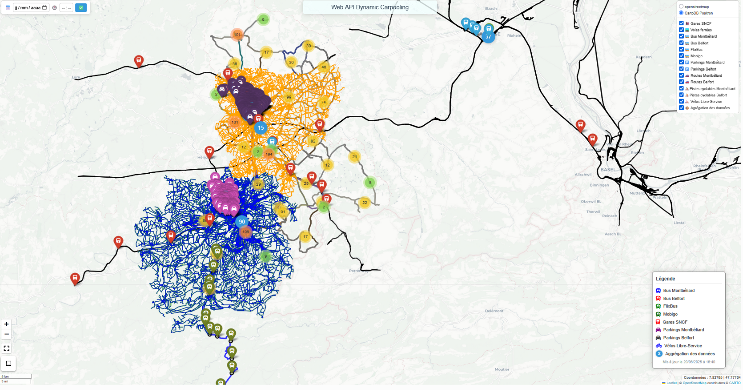
Data visualization

Slide 15
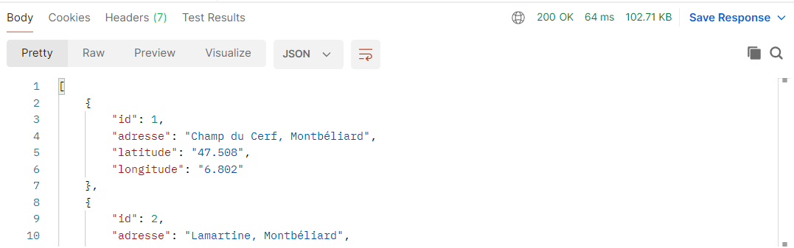
API
Goal : Programming a RESTful API to make itinerary requests
Routes are directly linked to what is inside the database : lines, locations, stops (+ mode)
Every route is subdivided within REST standards : GET (one or get all), PUT/PATCH (Edit), POST (Add), DELETE (Deletion)
Every route was developed in order to be used on the Web Interface
For further security, an authentication system using bearer tokens was programmed : that way, only a few users (operators of mobility) can access the routes if they know the credentials
The API will work 24/7 using a dedicated server

Slide 16
Web Interface
Goal : Implement / call every route from the API in a comprehensive, visual manner
First : go through the authentication page and login to receive a token, which will be passed on to future requests
For every page, a simple CRUD (Create, Read, Update, Delete) system is deployed
So you can do anything the API allows you to do
Especially used for stop series / travel visualisation : you can follow an itinerary from one stop to another
Trying to access pages without authentication token will not display the data

Slide 17
What’s next
Every part is done, what can be further done is :
Implementing everything inside a server
Aggregating more modes of transportation for the database

Slide 18
DEMONSTRATION

Slide 19
Data visualization
https://www.youtube.com/watch?v=zXJH5IIcqUU

Slide 20
Conclusion
Important project because of how important public transportation is in 2025 and beyond
Multimodal project with several abilities needed (API, Database, Algorithm, Data aggregation..)
Long project : will probably be finished in 2026
Following and perspectives : more user-oriented mode? More modes within the database?

Slide 21
THANK YOU

